Slide 1
Frontiers in tobacco treatment research:
Maximizing reach and efficacy with communication technology
Lorien Abroms, ScD
Associate Professor
Milken Institute School of Public Health
George Washington University
Health Communication:
Barriers, Breakthroughs, and Best Practices
HCB3
3/3/2017
Notes:
Thank-you for inviting me to present. I have been here on sabbatical between sept and dec and it’t great to get to know some of you. And I am enjoying the opportunity from today to get to know more of you.

Slide 2
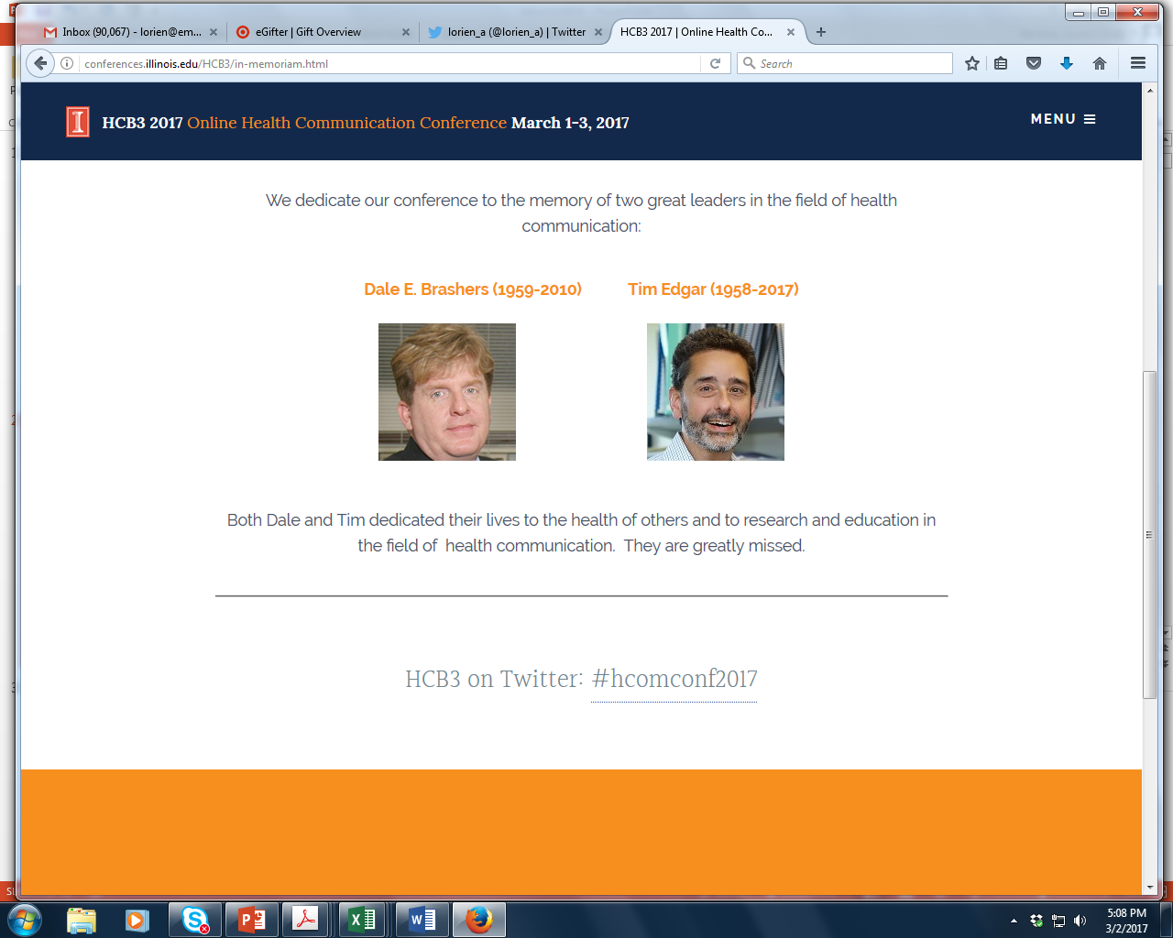

Slide 3
Disclosure
Dr. Abroms/GWU has licensed Text2Quit/Quit4baby to Voxiva Inc.
Funding Source
This research was supported by 5K07 (NCI), R15CA167586 (NCI), R44DA035017 (NIDA) to Dr. Lorien Abroms

Slide 4
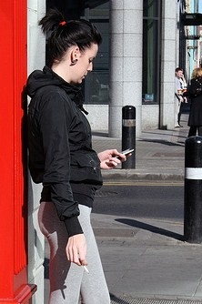
Aims of Talk
  Can mobile technology promote smoking cessation?
  What mechanisms are involved?
  Can mobile technology work for priority populations?
  Can technology promote reach?
Notes:
Today in my talk would like to tell you about my work at the intersection of tobacco treatment and comm technology and address the following 4 questions.

Slide 5
The Problem
Tobacco use is the leading preventable cause death
15% of US adults smoke
Smoking clustered in low SES groups:
    34.1% GED vs. 3.6% grad degree
    26.1% for below the poverty level vs. 13.9% living at or above the level
(CDC, 2015)
Notes:
So when talk about elminating disparities in cancer, eliminating smoking is key because it is a behavior that is so much more a problem of those with low ses.

Slide 6
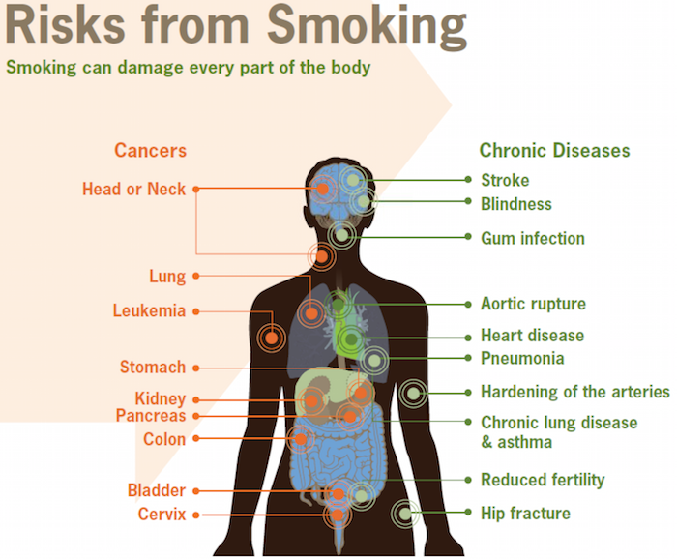
cdc.gov, 2016
Notes:
https://www.cdc.gov/tobacco/infographics/health-effects/index.htm#smoking-risks
Smoking is strongly associated with numerous cancers including XX
Leading prevenatble cause of death.

Slide 7
Technology Use
92% of US adults own a mobile phone -most commonly owned technological device (e.g. over laptop, mp3 player) 88% text with their phone 68% have smartphones 75% have used their phone to look up health information (Pew 2015; Pew 2014; CTIA 2014)
Notes:
Most of the technology I will talk about today is mobile phones; but also interested in X-box for gaming and EHRs.
We all in this room depend on computers , smartphones, and tablets. Perhaps Have accounts on twitter, instagram, facebook. But what are the current and future use patterns of the people we serve. In the case of smokers , who are low income, low education populations.

Slide 8
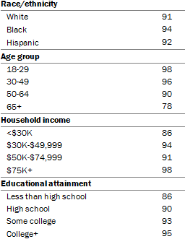
Common Across All Major Groups
Pew Research, 2015
Notes:
With the exception of age, all groups above 85% ownership: all ethnicity; all ages, all hh income including less than 30K, all education levels.

Slide 9
Low income smokers have mobile phones
Low income smokers at ED (N=562):
91.4% have cell phones, 63.2% cell phone only, 34.1% limited talk minutes (Bernstein et al. Nicotine & Tobacco Research, 2016)
Notes:
Establish that smokers, even low income smokers have cell phones.
Free (smart)phones offered through Lifeline to Medicaid insured
Cell phone only HH
While easy get a phone—Lifeline for Medicaid—still hard to maintain. Data. Wifi access. Keep Charged. LinkNYC kiosks.

Slide 10
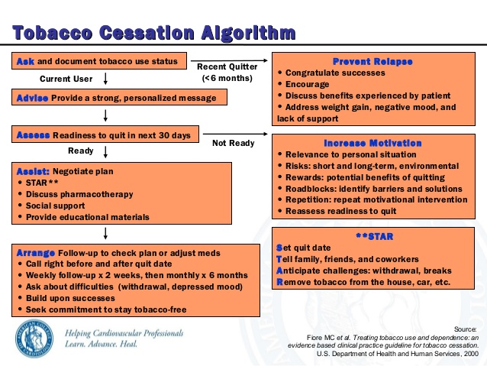
5A’s model of cessation
State of Smoking Cessation:
US Public Health Service Clinical Practice Guidelines (2008)
NRT
Varenicline/Chantix
Individual,
Group , Internet ,
Phone

Slide 11
State of smoking cessation
Progress…
US Public Health Service Clinical Practice Guidelines
  5A’s model
But….
Efficacy
  Most smokers relapse even with the best treatments
  Counseling effects are modest
  Not treated as chronic relapsing condition
Reach
  Limited reach in clinical setting, at most, only get 5-12% of presenting smokers to receive treatment
  Limited calls to quitline: 1-3% of smokers call in a given year
  People turning to unproven therapies: download apps (Abroms et al. 2014) and seek out other therapies (e-cigarettes)
Baker et al., Addiction, 2015
Notes:
Because not treated as chronic, not reach people in all stages, interactions not studied…
Prev Med. 2010 Sep-Oct;51(3-4):199-213. doi: 10.1016/j.ypmed.2010.06.007. Epub 2010 Jun 17.
Strategies to increase the delivery of smoking cessation treatments in primary care settings: a systematic review and meta-analysis.
Papadakis S1, McDonald P, Mullen KA, Reid R, Skulsky K, Pipe A.
Author information
Abstract
OBJECTIVES:
A systematic review and meta-analysis was conducted to evaluate evidence-based strategies for increasing the delivery of smoking cessation treatments in primary care clinics.
METHODS:
The review included studies published before January 1, 2009. The pooled odds-ratio (OR) was calculated for intervention group versus control group for practitioner performance for "5As" (Ask, Advise, Assess, Assist and Arrange) delivery and smoking abstinence. Multi-component interventions were defined as interventions which combined two or more intervention strategies.
RESULTS:
Thirty-seven trials met eligibility criteria. Evidence from multiple large-scale trials was found to support the efficacy of multi-component interventions in increasing "5As" delivery. The pooled OR for multi-component interventions compared to control was 1.79 [95% CI 1.6-2.1] for "ask", 1.6 [95% CI 1.4-1.8] for "advice", 9.3 [95% CI 6.8-12.8] for "assist" (quit date) and 3.5 [95% CI 2.8-4.2] for "assist" (prescribe medications). Evidence was also found to support the value of practice-level interventions in increasing 5As delivery. Adjunct counseling [OR 1.7; 95% CI 1.5-2.0] and multi-component interventions [OR 2.2; 95% CI 1.7-2.8] were found to significantly increase smoking abstinence.
CONCLUSION:
Multi-component interventions improve smoking outcomes in primary care settings. Future trials should attempt to isolate which components of multi-component interventions are required to optimize cost-effectiveness.
Natural history of attempts to stop smoking.
Hughes JR1, Solomon LJ2, Naud S3, Fingar JR2, Helzer JE2, Callas PW3.
Author information
Abstract
INTRODUCTION:
This study provides a prospective fine-grain description of the incidence and pattern of intentions to quit, quit attempts, abstinence, and reduction in order to address several clinical questions about self-quitting.
METHODS:
A total of 152 smokers who planned to quit in the next 3 months called nightly for 12 weeks to an Interactive Voice Response system to report cigarettes/day, quit attempts, intentions to smoke or not in the next day, and so forth. No treatment was provided.
RESULTS:
Most smokers (60%) made multiple transitions among smoking, reduction, and abstinence. Intention to not smoke or quit often did not result in a quit attempt but were still strong predictors of a quit attempt and eventual abstinence. Most quit attempts (79%) lasted less than 1 day; about one fifth (18%) of the participants were abstinent at 12 weeks. The majority of quit attempts (72%) were not preceded by an intention to quit. Such quit attempts were shorter than quit attempts preceded by an intention to quit (<1 day vs. 25 days). Most smokers (67%) used a treatment, and use of a treatment was nonsignificantly associated with greater abstinence (14 days vs. 3 days). Making a quit attempt and failing early predicted an increased probability of a later quit attempt compared to not making a quit attempt early (86% vs. 67%). Smokers often (17%) failed to report brief quit attempts on an end-of-study survey.
CONCLUSIONS:
Cessation is a more chronic, complex, and dynamic process than many theories or treatments assume.

Slide 12
Bottom line
“We are losing control” (Baker, 2016)
  Not coming to our quitlines
  Not making appointments with doctors
We need population level innovation
  Better efficacy of treatments
  Better reach

Slide 13

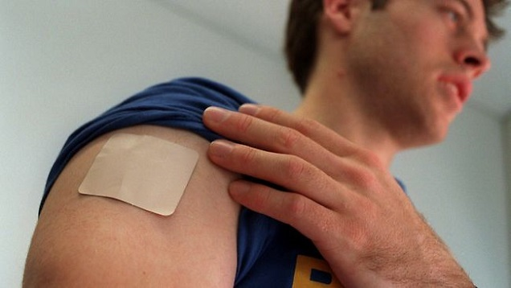


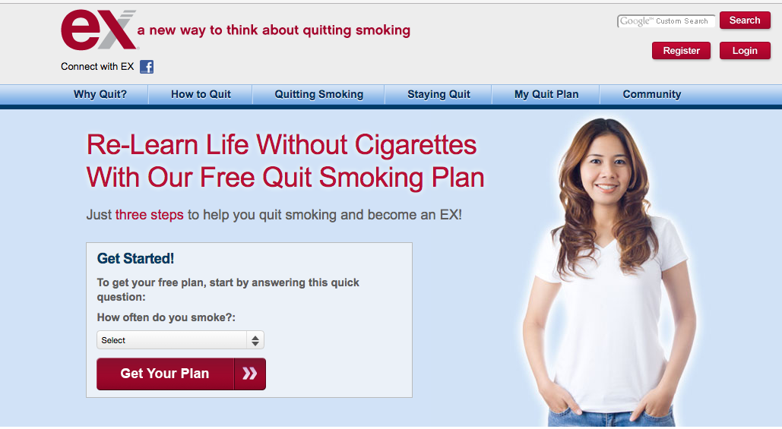
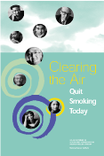

Impact= Efficacy X Reach
40-50%
mCessation
(Mobile phone Cessation)
Efficacy
(Quitrates)
?
5%
1-on-1
counseling
group
counseling
phone
counseling
Internet/Tailored Communication
Self-help brochure
Mass Media
Reach
(Adapted from Brandon, 2016)
Notes:
Look at current treatments, generally tradeoff reach and efficacy.
Bill gates: is this about those that regularly exercise 90% of the time moving to 95% of the time or really helping people make changes, changes that are not just incremental improvements for the motivated.
How can we do better on reach and efficacy
; improved efficacy above what we have with doctors, with groups . Phone, . How reach more people so more people reach out to us for help; so that we do a better job of reaching out. I think we can do better with communication technology on both fronts.
For the most part there are not head to head trials with these various forms of counseling and persuasion but overall , according to US Public Health Service Clinical Practice Guidelines, more sessions of counseling is better and more minutes of counseling is better.
Where does mobile fit in? What are the opportunities for even greater reach while maintaining or improving efficacy? Especially as people are turning to apps more than quitlines, more than clinics.
14% of attempts with NRT (NHIS 2010)

Slide 14
Aims of Talk
  Can mobile technology promote smoking cessation?
  What mechanisms are involved?
  Can mobile technology work for priority populations?
  Can technology promote reach?
Notes:
Today in my talk would like to tell you about my work at the intersection of tobacco treatment and comm technology and address the following 4 questions.

Slide 15
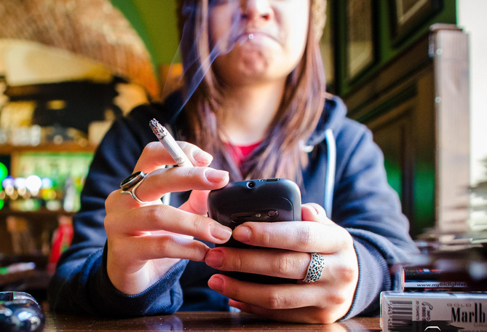
Rationale for mCessation
1. Reach: Help anywhere and anytime
2. Proactive messages interrupt you
3. Interactive help
4. Personalized help
5. Increase contact time
6. Unobtrusive and confidential
7. Opportunities for tracking of smoking
8. Goes with smoking
Abroms LC, Padmanabhan N, and Evans WD. 2012, “Using Mobile Phones for Health Promotion.” In S.M. Noar & N.G. Harrington (Eds.), eHealth Applications: Promising Strategies for Behavior Change. New York: Routlegde, 147-166.

Slide 16
Drawbacks of mCessation
Technological challenges to deliver
Technological challenges to receive (e.g. charged)
Financial challenges to have service; “On and off the grid” (e.g service, data)
Privacy
Notes:
Device when used for talking may be a carcinogen, emits radiation.

Slide 17

Study of Text2Quit
Automated, interactive, personalized text messages for quitting smoking
Messages are timed around quit date
Proactive: Advice on quitting, peer ex-smoker messages, medication msgs, games, and relapse messages.
On-Demand: need additional motivation, having a craving, relapse.
2-3 messages/day following quitdate
Developed in 2011
Abroms LC, Boal AL, Simmens SJ, Mendel JA, Windsor RA. A randomized trial of Text2Quit: a text messaging program for smoking cessation. Am J Prev Med. 2014 Sep;47(3):242-50.
Notes:
Developed for a time pre-smartphones tho still in use today. At time no evidence.

Slide 18
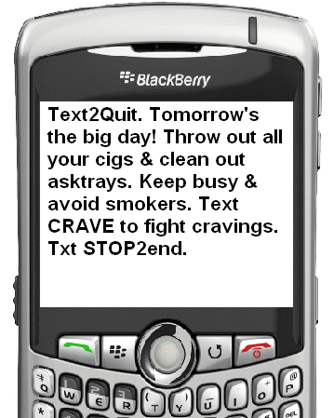
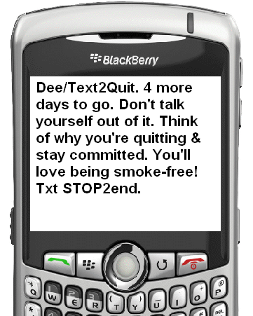
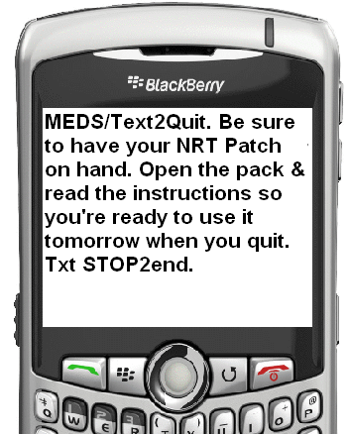
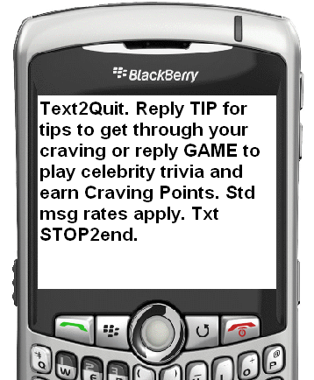
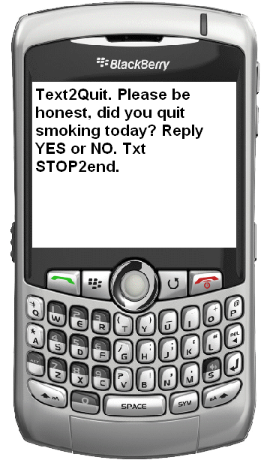
Advice on Quitting
Peer ex-smoker
msg
Text2Quit. Tomorrow’s the big day! Throw out all your cigs before bed. Plan to keep busy & avoid smokers. Text CRAVE to fight cravings.cravings.
Erika/Text2Quit. 4 more days to go. Don’t talk yourself out of it. Think of why you’re quitting and stay committed. You’ll love being smokefree! cravings.
Medication msg
On demand games & tips
Check-ins
MEDS/Text2Quit. Be sure to have your NRT Patch on hand. Open the pack & read the instructions so that you’re ready to use it tomorrow in the morning. cravings.
Text2Quit. Reply GAME to play trivia and earn Text2Quit points. Cr
avings.
Text2Quit. Did you quit smoking today? Reply YES or NO.
cravings.

Slide 19
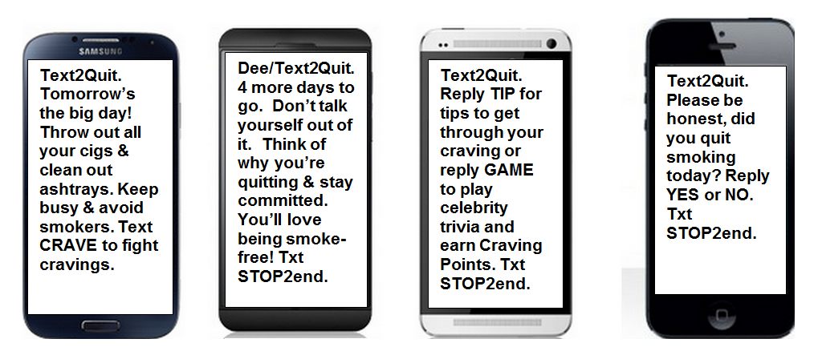
Personalization
Reasons
Text2Quit. Lorien’s reasons to quit are: To improve my health, To save money, So that I can be there for my kids Lailah, David & Maya
  Reasons for quitting
  Triggers
  Gender
  Use of pharmacotherapy
  Stats on money saved and health benefits accrued
Notes:
Personalized medicine
Down side of personalization is it is a pain to enroll.

Slide 20
Interaction:
Pledge
    Track cigarettes smoked
    Track how day went (urges and smoking)
    Weekly smokefree pledge
    Surveys: “Are you ready?”“Did you Quit?”
Pre-Quit Tracking
Text2Quit. Time for a pre-quit check-in. Reply with the number of cigarettes you smoked yesterday (e.g. 16). Find out if you've met your goal.
PLEDGE/Text2Quit. Make a pledge towards a smokefree life and get your latest Text2Quit quitting stats.
Reply PLEDGE.
Notes:
And results of survey inform protocol. In a sense a just in time adaptive intervention.
PLEDGE/Text2Quit. Make a pledge towards a smokefree life and earn T2Q points and get your latest Text2Quit quitting stats. Reply PLEDGE.

Slide 21
24-7 Help
  CRAVE
  SMOKED
  STATS
(1/2) Text2Quit. Sorry to hear you smoked! You made a mistake, but you can go back to being a non-smoker.
(2/2) Is this a SLIP where you can go back to not smoking? Or RELAPSE where you are now smoking again? Reply SLIP or RELAPSE.
Notes:
21

Slide 22
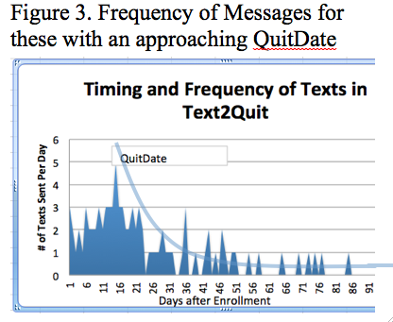

Slide 23
Randomized Trial of Text2Quit
Participants recruited on the Internet with Google ad words
Randomized to receive Text2Quit or a self-help material (Smokefree.gov; Clearing the Air).
Surveyed at baseline, 1, 3, and 6 months post-enrollment to assess smoking status.
  Saliva collected from self-reported quitters at 6 months
Those lost to follow up were categorized as smokers.
Abroms LC, Boal AL, Simmens SJ, Mendel JA, Windsor RA. A randomized trial of Text2Quit: a text messaging program for smoking cessation. Am J Prev Med. 2014 Sep;47(3):242-50.

Slide 24
Be Free Study (N=503)
33.2%
31.7%
30.5%
20.7%
19.9%
No Smoking in the Past 7 days
14.5%
Abroms LC et al, Am J Prev Med. 2014
Notes:
1 month : doubling; at 3 months effect is slightly attenuated but still significant.

Slide 25
 | Follow-up Survey | Measure | Intervention (SE) (n = 262) | Control (SE) (n = 241) | Relative risk (95% CI)
Primary outcome |  | Biochemically confirmed RPP abstinence | 11.1% (.02) | 5.0% (.01) | 2.22 (1.16 – 4.26)*
 |  | Self-reported RPP abstinence^{b} | 19.9% (.02) | 10.0% (.02) | 1.99 (1.27 – 3.13)**
Secondary outcomes | 6 Months | Biochemically confirmed abstinence | 15.7% (.02) | 11.2% (.02) | 1.40 (.89 – 2.20)
 |  | Not smoked in the past 7 days (%) | 31.7% (.03) | 20.8% (.03) | 1.53(1.13 – 2.07)**
 |  | Not smoked in the past 30 days (%) | 24.8% (.03) | 15.8% (.02) | 1.57 (1.10 – 2.26)*
 | 3 Months | Not smoked in the past 7 days (%) | 33.2% (.03) | 19.9% (.03) | 1.67 (1.23 – 2.26)**
 |  | Not smoked in the past 30 days (%) | 27.5% (.03) | 16.2% (.02) | 1.70 (1.20 – 2.41)**
 | 1 Month | Not smoked in the past 7 days (%) | 30.5% (.03) | 14.5% (.02) | 2.10 (1.47 – 3.00)***
 |  | Not smoked in the past 30 days (%) | 11.8% (.02) | 7.5% (.02) | 1.58 (.91 -2.76)
Table 2. Relative risk for smoking outcomesª (n = 503)
Abroms LC et al, Am J Prev Med. 2014
Notes:
Increase long-term

Slide 26
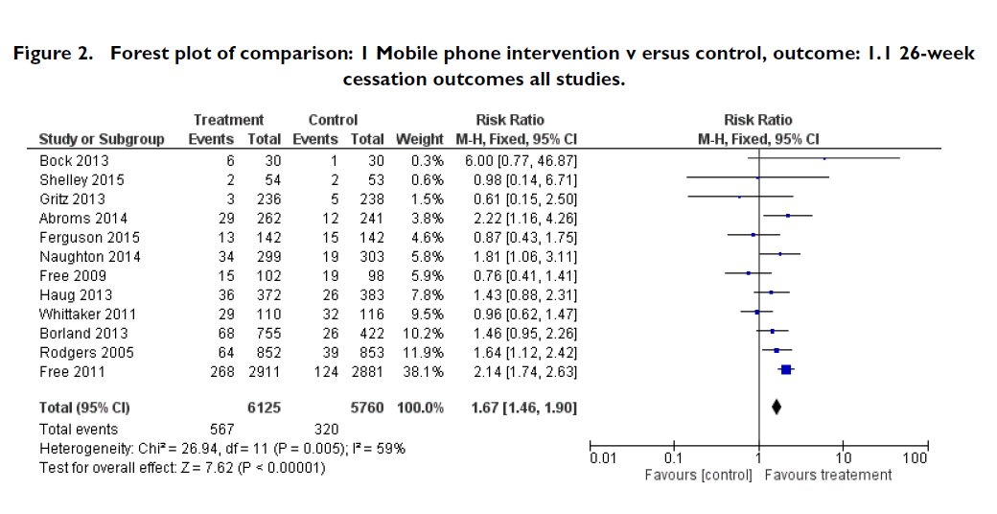
Cochrane Review
N=12
Whittaker R, et al.. Mobile Phones for Smoking Cessation. Cochrane Review. 2016
Notes:
These are all randomized designs with at least 6 months follow-up
70% increase in likelihood of quitting with mobile program; increase long term quit rates by 70%
Almost all programs use text messaging; none used an app

Slide 27
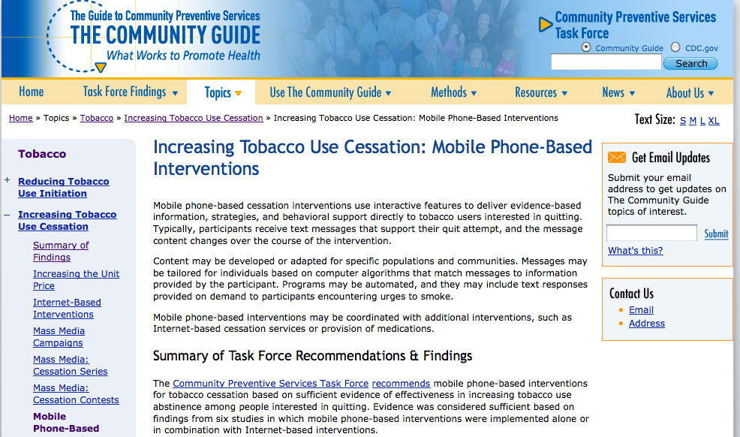
US Preventive Services
Notes:
came from six studies which evaluated the effectiveness of interventions that used automated text messaging for previously recruited participants who were willing to make an attempt to quit smoking.
All the studies were randomized controlled trials and assessed either self-reported or biochemically verified cessation outcomes at 6 or 12 months.
6 studies
None from US
Whittaker R, Borland R, Bullen C, et al. Mobile phone-based interventions for smoking cessation. Cochrane Database of Systematic Reviews 2009, Issue 4, Art. No.: CD006611. DOI: 10.1002/14651858.CD006611.
Weakness – not in US; no economic data published

Slide 28
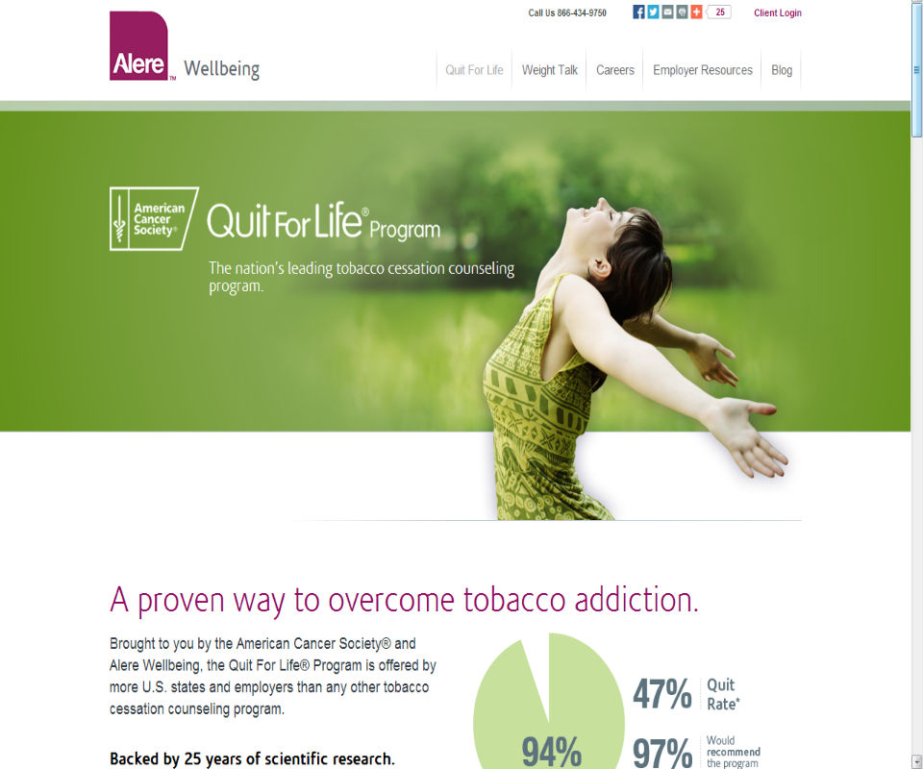

-Covers 27 States, 675 employers/health plans
-Participants receive:
multiple outbound coaching calls, 2) Web Coach® 3) Text2QuitSM
-Over 200,000 callers enrolled in Text2Quit
+
Notes:
As of 2012, Text2Quit became part of quit4life, an ACS/Alere program and has been offered to 75,000 people in conjunction with phone counseling and web coach.
For some aspects, users can change their service elections on one system (e.g. Text2Quit) and have the changes be instantly reflected on the other systems (e.g. phone counseling, Web Coach). This is the case for setting and changing a quit date, use of quit smoking medications, and tracking smoking prior to the quit date.
Another form of integration is that users of Text2Quit receive reminder text messages one day in advance of each upcoming counseling call.
.

Slide 29
Aims of Talk
  Can mobile technology promote smoking cessation?
  What mechanisms are involved?
  Can mobile technology work for priority populations?
  Can technology promote reach?
Notes:
Today in my talk would like to tell you about my work at the intersection of tobacco treatment and comm technology and address the following 4 questions.

Slide 30
Texts constantly reminded me about my plan to quit.”
“That you can [SMS] whenever you are feeling the urge to smoke and in that time frame you are actually not smoking...”
“Someone kind of there with you…” “Like a constantly concerned friend”
“Texts gave good ideas on how to fight cravings ….”
Abroms et al. 2013

Slide 31
“OMG. TOO MANY TEXTS PER DAY.”
“I would like it more if there was an actual coach ...”
“Sometimes I would be doing really good…then I would get a text and it would make me start craving and thinking about smoking.”
Abroms et al. 2013

Slide 32
Psychosocial or Extra-Treatment?
(N=409)
Same rates of extra-treatment (e.g NRT, quitline, counseling, 1-on1 , self-help materials, online community) at 1 mo
Text2Quit had greater increases in psychosocial (self-efficacy) compared to control (p<.01) at 1mo
Self-efficacy significant mediator of effect.
  Accounts for 51.1% of the effect of Text2Quit on Cessation at 6 months
  Only variable with a complete mediational path
➔Text messaging programs may be appropriate in low/middle income countries
Hoeppner B,, et al. Addiction. 2016.
Notes:
This is important because good to know ; also because WHO is scaling up in countries where little quitline or NRT access. India, costa rica, tunisia.

Slide 33
Logic Model for mHealth & Smoking Cessation
Proximal outcomes
(Extra-treatment)
Health outcome
mHealth inputs (SMS)
Intermediate outcomes (Psychosocial)
Proactive Reminders
Call quitline
Use NRT /medications
Info on how to quit
Social support
Talk to doctor
Miniquit
Self-efficacy
Quit smoking
Online community
Tracking & feedback
Benefits
Barriers
Tools if craving/slip
Behavioral capability
Pledge
Hoeppner B,, et al. Addiction. 2016.

Slide 34

Does it work at a quitline?
+
Natural experiment in commercial quitline setting with rollout of Text2quit
Propensity score matching on intake covariates
  Control Group: 4-call Phone Counseling, NRT, WebCoach (N=4363)
  Enhanced group: control +Text2Quit (N=4363)
Result: Similar rates of 7-day abstinence were reported for both groups at 7 mo (25.3%/25.5%)
Text2Quit more satisfied
➔Text2Quit not confer benefit for quitting in tandem with quitline services
Boal, A, Abroms LC, Graham A. Simmons S. Combined Quitline Counseling and Text Messaging for Smoking Cessation: A Quasi-Experimental Evaluation. Nicotine & Tobacco Research. Oct 31, 2015.
Notes:
Objective: To determine whether comprehensive quitline services combined with text
messaging improve smoking cessation rates beyond those achieved by offering
comprehensive quitline services alone.
Methods: The study sample consisted of callers to the Alere Wellbeing, Inc.
commercial quitline in 2012. A quasi-experimental design was implemented using
propensity score matching to create the intervention and control groups. The
intervention group consisted of those who were offered and accepted a text message
intervention in addition to usual quitline services, while the control group consisted of
those who were not offered the text message intervention. Analyses utilized baseline
data collected at intake, program use data (e.g., call history and text message use),
and reports of smoking behaviors and program satisfaction collected 6 months after
intake.
Results: Similar rates of 7-day abstinence were reported regardless of whether
participants received combined multi-call quitline services plus text messaging (25.3%)
or multi-call quitline services in isolation (25.5%), though those who received combined
services reported significantly higher treatment satisfaction. Among those who
received combined services, the number of text messages sent to the text message
program predicted 7-day abstinence such that those who sent more text messages
were less likely to report 7-day abstinence.
Conclusions: Text messaging may not confer additional benefits over and above those
received through multi-modal, multi-call quitline programs. Future research should
investigate whether text messaging programs improve quit rates when combined with
less intensive services such as single-call phone counseling.

Slide 35
Implications
Based on my study and those of others, SMS programs increase long term quit rates by 70%
Mechanism is primarily psychosocial rather than extra-treatment
Offers no additional benefit beyond comprehensive quitline treatments (counseling, NRT, webcoach)

Slide 36
Aims of Talk
  Can mobile technology promote smoking cessation?
  What mechanisms are involved?
  Can mobile technology work for priority populations?
  Can technology promote reach?
Notes:
Today in my talk would like to tell you about my work at the intersection of tobacco treatment and comm technology and address the following 4 questions.

Slide 37
Can mCessation work for pregnant smokers?

Slide 38
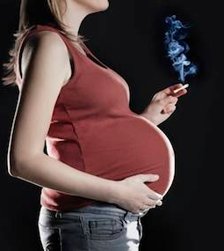
Smoking in Pregnancy
10-15% smoke through their pregnancy
Harms from smoking to developing baby
While counseling works, low Reach of programs
    Few get help from OB
    Few call quitlines (<1% of calls) (NAQC 2014)
    78% of identified smokers refuse in-person counseling (Windsor et al. 2014)
First large scale study: No efficacy data from RCT for mCessation in pregnant women

Slide 39
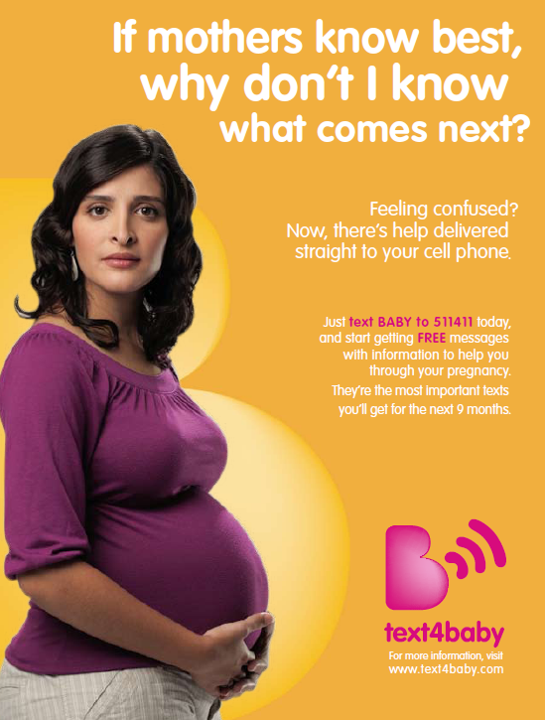





















Text4Baby
Core Partners:
Outreach Partners:
Telecoms industry support:
1million + subscribers since launch (2011)
Send free text-messages to pregnant users (3x/week), timed around due date on a variety of health topics
39
Notes:
Spreading to other vulnerable populations
39

Slide 40


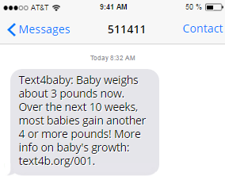
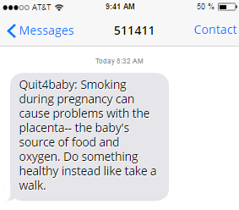

Slide 41
Quit4baby
Automated, interactive, personalized text messages for quitting smoking
Messages are timed around quit date and baby’s due date
Proactive: Advice on quitting related to benefits to mom and baby, facts on harms of smoking to mom and baby, peer ex-smoker messages, and relapse prevention messages.
Surveys and On-Demand keywords
5+ messages/day following quitdate

Slide 42
Quit4baby Recruitment Consort Diagram

Slide 43
Demographics
87% HH income is < $30,000/year
~80% Medicaid insurance
Enrolled in all trimesters

Slide 44
Participant Quit Rate : by Follow-Up
Abroms et al. under review
Abroms LC, Johnson P. Leavitt LE, Cleary SD, Chiang SC, Brandon TH
Bushar J. A Randomized Trial of a Text-Messaging Program to Promote Smoking Cessation in Pregnant Women. Under review

Slide 45
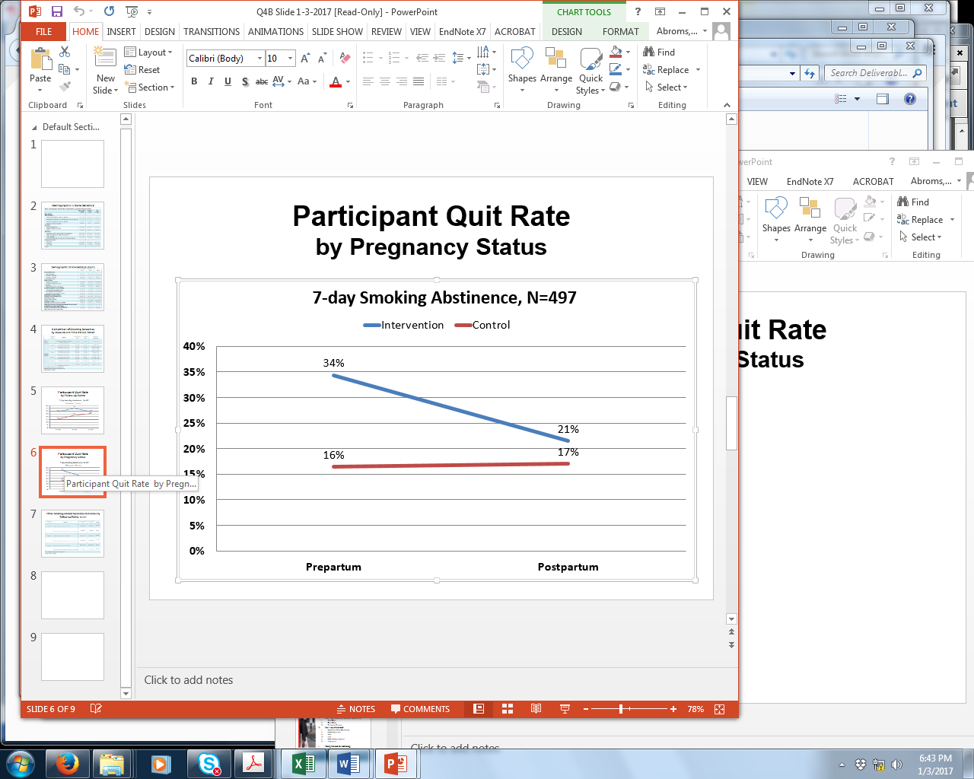
Abroms et al. under review

Slide 46
Quit4baby Summary & Conclusions
Significant difference in past 7 day smoking at 1 ,3 months
Biochemically verified quitting not significant overall but significant for subgroups (older, past first trimester)
Prepartum effects but not postpartum effects.
Encouraging findings for mCessation in pregnant women
Abroms LC, et al. . Under review

Slide 47
Aims of Talk
  Can mobile technology promote smoking cessation?
  What mechanisms are involved?
  Can mobile technology work for priority populations?
  Can technology promote reach?
Notes:
Today in my talk would like to tell you about my work at the intersection of tobacco treatment and comm technology and address the following 4 questions.

Slide 48
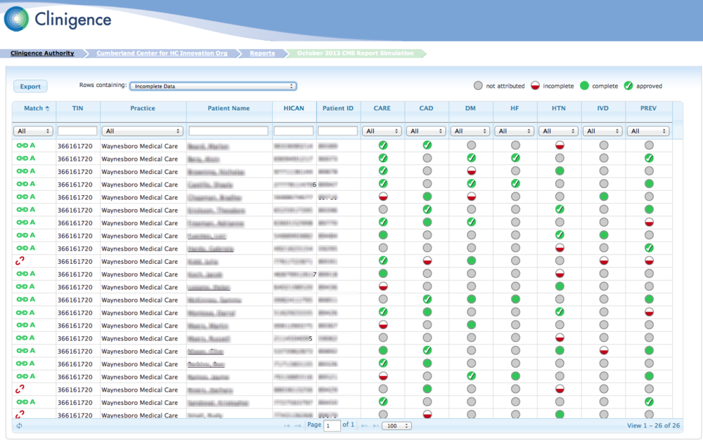
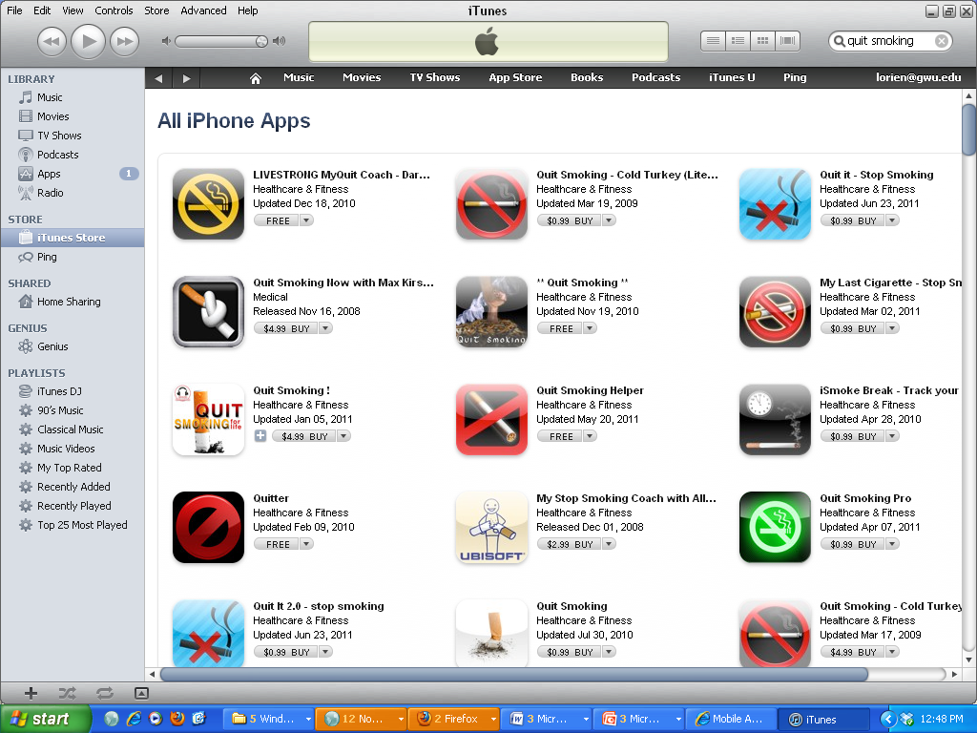

Connecting the digital dots
Digital Registries
EHRs
Apps/texting programs
Mobile Phones

Slide 49

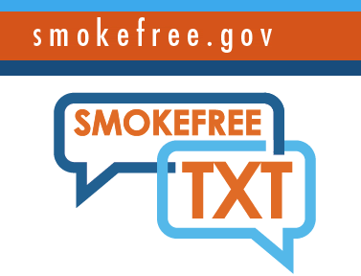

Reactive: make it available
Smokefree.gov (SmokefreeTXT and SmokefreeMom)
  Combined enrollment 200,000+ since 2012
WHO Be Heathly Be Mobile: working with 11 low and middle income countries to scale at national level
+

Slide 50
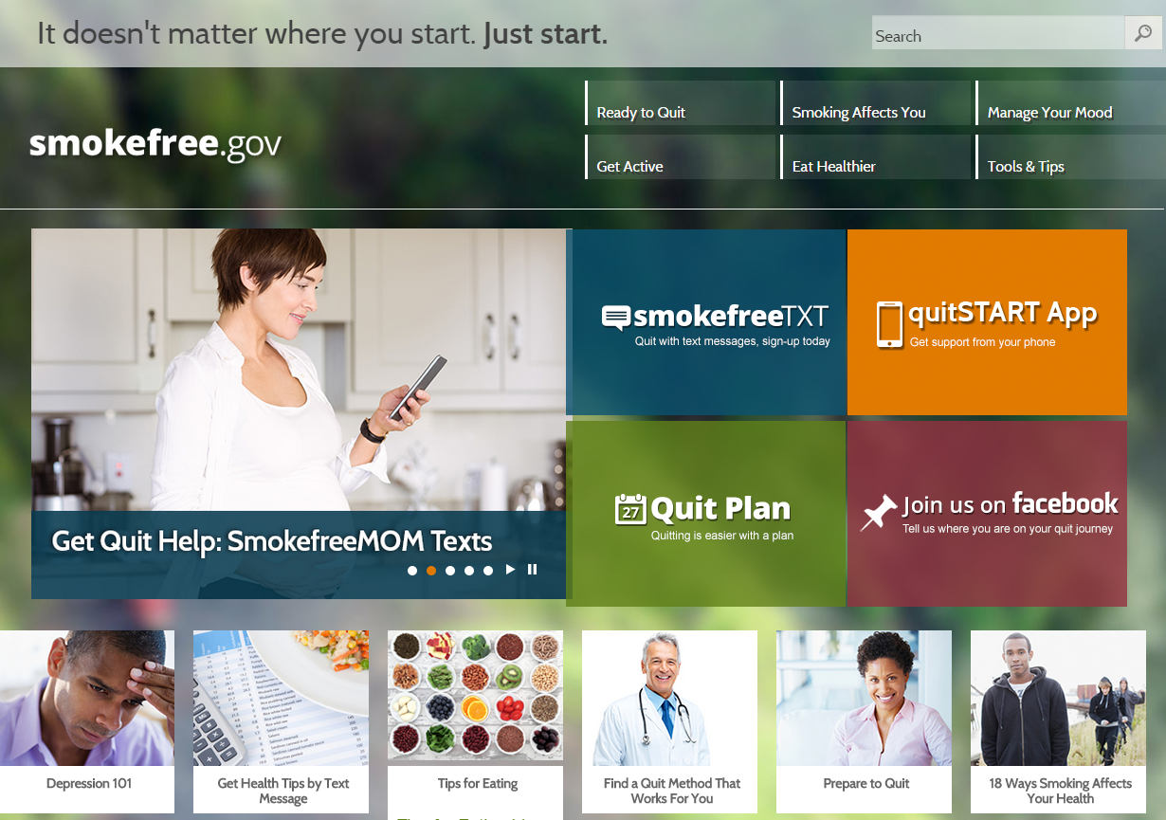

N=800 approx subscribers

Slide 51
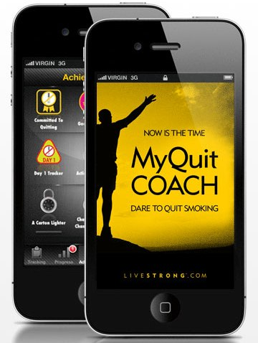
Sampling Process
15,000 consumer health apps;
400+ smoking cessation apps across Android and iOS (Abroms et al. 2013)
Power Search for “quit smoking”, “stop smoking”, and “smoking cessation”
100,000+ Apps in iTunes Store
71 Apps
Assess relevance from app description
3,025,000-12,302,000 installs from top 50 Apps in 3 month
~1 million monthly global downloads
47 Apps in Sample
Download available apps
52 Apps
Abroms LC, Lee Westmaas J, Bontemps-Jones J, Ramani R, Mellerson J. A content analysis of popular smartphone apps for smoking cessation. Am J Prev Med. 2013 Dec;45(6):732-6.
Notes:
Whereas there is no central repository of text messaging programs, b/c of the way that apps work, there is a central repository in the form of the iTunes app store and the android market. Apple revolutionized apps by promoting access to 3rd party developers.
51

Slide 52
Proactive: do outreach with digital lists
SMS Outreach for SMS program
  India government employees list
  Text4baby list
  GW MFA: smoker patient list

Slide 53
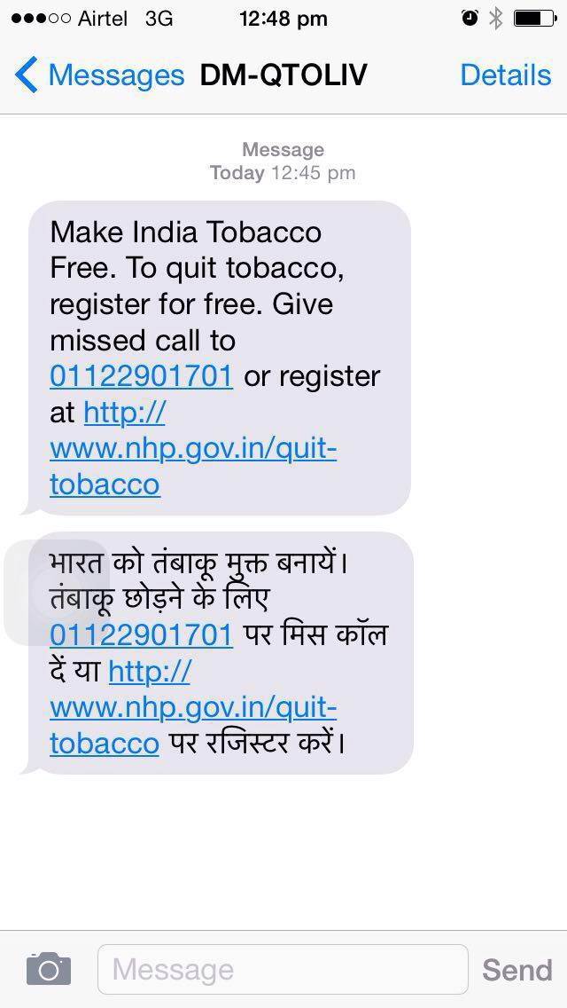
30 million Promotional SMS sent via gov directories
Whittaker R, Abroms, L & Murthy P. WHO Presentation. 2016

Slide 54
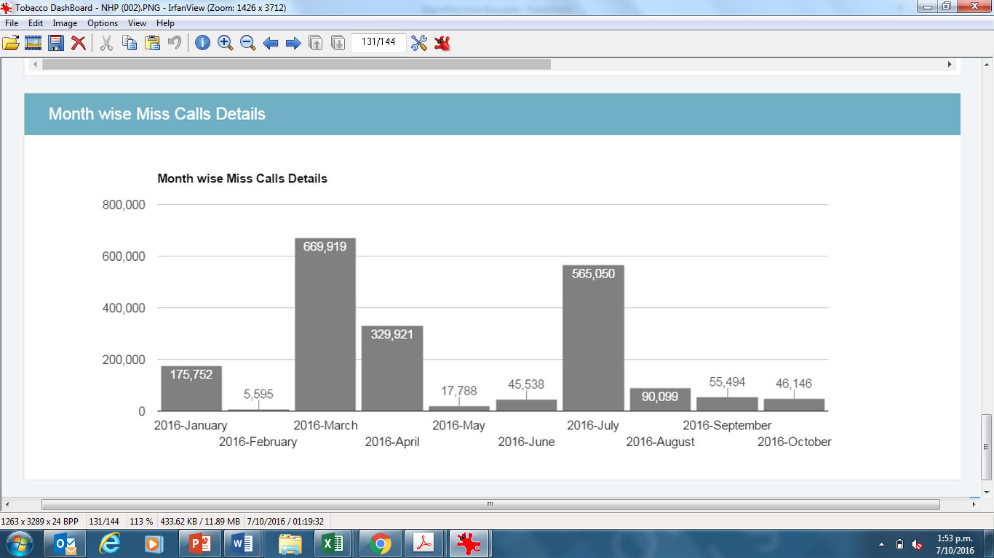
N=1.8 million enrollments over the span of 10 months (6%)
Whittaker R, Abroms, L & Murthy P. WHO Presentation. 2016
Notes:
Go from no national program to 2 million enrolled in matter of months.

Slide 55
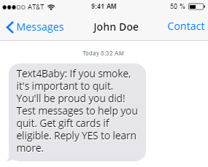
Innovation in Enrollment:
Exploit digital subscriber lists
Recruitment through Text4baby was feasible and effective
  Most people responded within minutes
Emotional framing influences interest
  But study enrollment rate did not significantly differ between messages
Other message elements influenced recruitment
  Adding urgency to SMS response doesn’t matter
  Removing incentive does matter
Leavitt L, Abroms LC, Johnson P, Schindler-Ruwisch J, Bushar J, Singh I, Cleary SD, McInvale W, Turner M. Recruiting pregnant smokers from Text4baby for a randomized controlled trial of Quit4baby. Transl Behav Med. 2016 Dec 1.
Leavitt et al. , 2016, TBM
Notes:
Text4Baby is a trusted source of health information
Persistent and frequent follow-up to enroll
Framing of initial message is important

Slide 56
Enrollment through a registry model
Identify patients from EHR
Send invitation SMS
Patient opts-in
GW MFA: GW now offers a service to help smokers quit smoking. Reply 1 for help via phone counseling, 2 for automated SMS and 3 for an appointment with your doctor.
Abroms, LC; Phoenix, J; Borden W; Elf, J; Tercyak K.
“Using Text Messaging for Outreach and Cessation Services in Health Systems”

Slide 57
Reach Summary
Reactive. They will come; some success, especially for general smoking cessation apps (but not pregnancy apps) (Heminger et al. 2016)
SMS Outreach for SMS program
  Found success both in India and Quit4baby (+T4B); Open question whether will work from a health system.
Notes:
But real value is proactive.

Slide 58
Aims of Talk
  Can mobile technology promote smoking cessation?
  What mechanisms are involved?
  Can mobile technology work for priority populations?
  Can technology promote reach?
Notes:
Today in my talk would like to tell you about my work at the intersection of tobacco treatment and comm technology and address the following 4 questions.

Slide 59
Scientific Take Home Points
  Can mobile technology promote smoking cessation?
    Yes, multiple RCT indicate that 70% increase in likelihood of quitting.
  What mechanisms are involved?
    Psychosocial changes
  Can it work for priority populations?
    Yes, evidence for pregnant smokers
  Can technology promote reach?
  Yes, both reactive and proactive methods
Notes:
But priority populations will need proactive.

Slide 60
Impact= Efficacy X Reach
40-50%
mCessation
(Mobile phone Cessation)
Efficacy
(Quitrates)
5%
1-on-1
counseling
group
counseling
phone
counseling
Internet/Tailored Communication
Self-help brochure
Mass Media
Reach
(Adapted from Brandon, 2016)
Notes:
With technology we do have the evidence that we can offer efficacious interventions and increase reach.

Slide 61
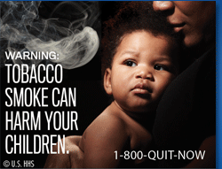
The future…
With technology, we can increase both reach and efficacy
The future is one where no patient screened in EHR as smoker leaves the clinical visit untreated
Smokers search for apps and digital programs and find ones proven to work
To quit, text “Quit” to 47848
Notes:
These are not pie in the sky; these require some investment but the technology is there.

Slide 62
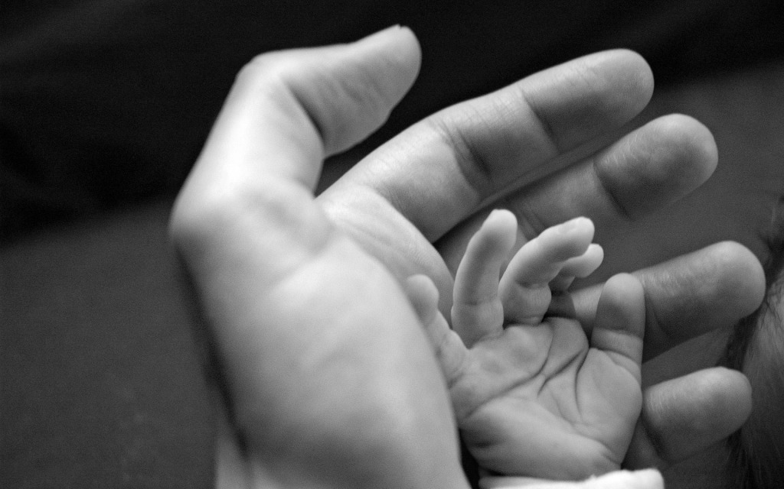
Acknowledgments: Thank-you!
Faculty
A. Graham, Schroeder
S. Cleary, GWU
T. Brandon, Moffitt
S. Bernstein, Yale
C Heminger, GWU
A. Boal, consultant
P. Johnson, Voxiva
S. Simmens. GWU
M. Turner, GWU
Donna Shelley, NYU
D. Evans, GWU
B Hoeppner, Harvard
K. Tercyak, Georgetown
L Westmaas, ACS
K. Carpenter, Optum
J. Shuter, Montifiore
R. Whittaker, U of Auckland
P. Murthy, National Institute of Mental Health & Neuroscience, India
Students and Staff
L Leavitt, Consultant
S. Chiang GWU
J Schindler-Ruwisch, GWU
J. Mendel, GWU
S. Fallon, Georgetown
J Bontemps-Jones, ACS
Allison Goldstein, WHO
Participants in trials:
Text2Quit
Quit4baby
Notes:
Daniel Greenberg, Marc Fishman
Kim horn
(ed maibach)

